Slide 1

How to write a machine learning related scientific article
Author
Comănac Dragoș-Mihail

Slide 2


Why?

Slide 3
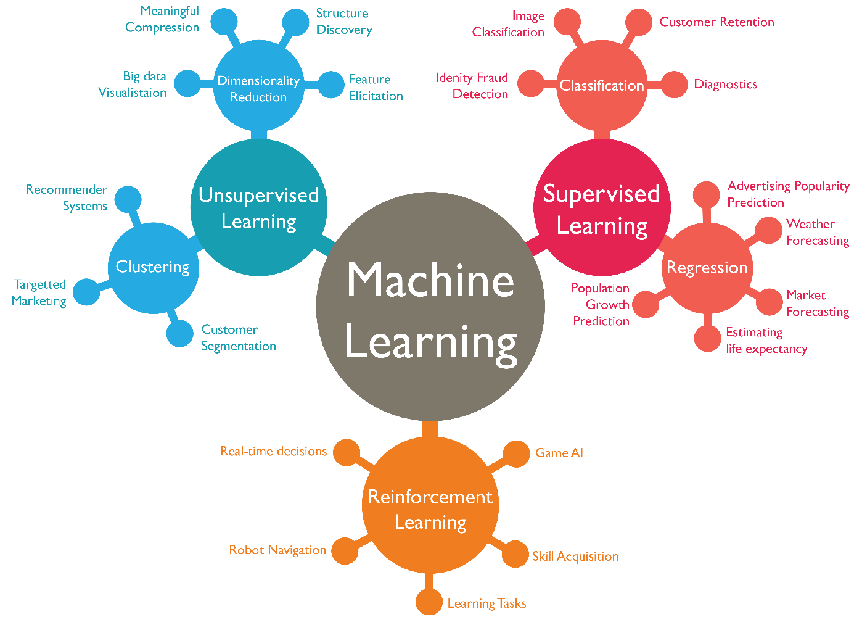
Placement in the broader field

Slide 4
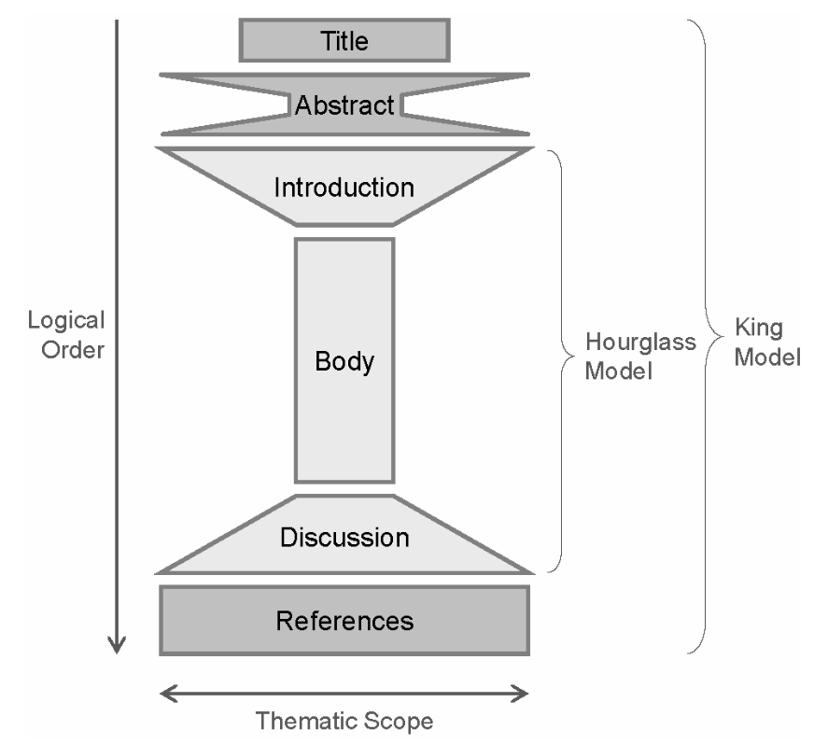
How?

Slide 5
Title

Slide 6
Abstract

Slide 7
Introduction

Slide 8
Body

Slide 9
Discussions

Slide 10
References

Slide 11
Dissemination

Slide 12
Conclusions

Slide 13
Thank you!

